Slide 1

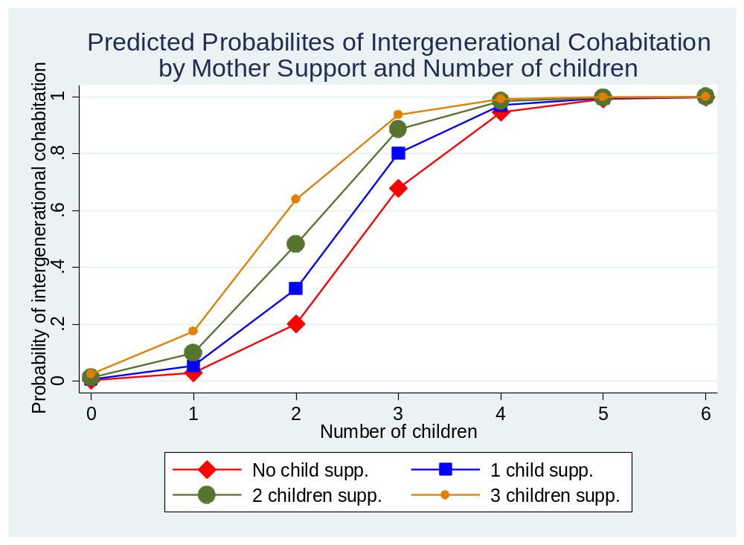
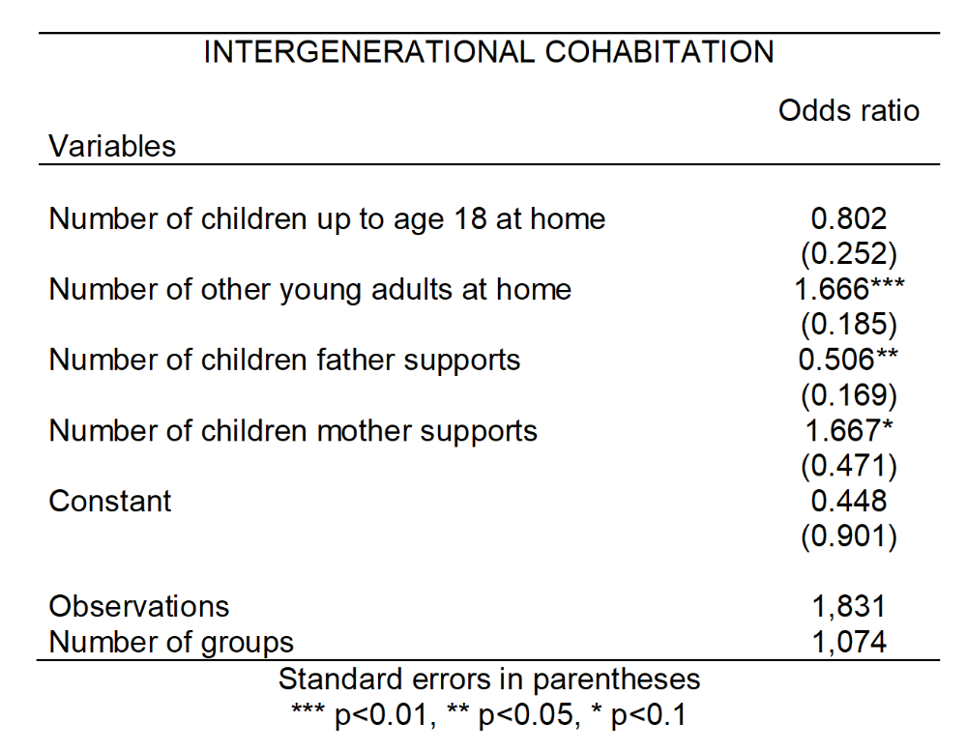
There is no place like the parents' home –
Examining the influence of parental familialistic solidarity on cohabitation between young adults and their parents across Europe.
LEAD
Graduate School & Research Network
Julia C. Büschges^{1,2} and Isabelle Fischer³
¹ Robert Koch Institute Berlin, Department of Epidemiology and Health Monitoring, Physical Health Unit, Germany
² Free University Berlin, Institute of Sociology, Germany
³ LEAD Graduate School & Research Network, University of Tübingen, Germany
MOTIVATION
Factors that encourage intergenerational cohabitation (IC) to relevant need patterns not met by social policies.
Although the topic seems straight forward, the moderate explanatory power of numerous papers bears witness to its covert complexity.
METHODOLOGICAL APPROACH
Theory-driven analyses including twelve European countries
Multi-level models: adult children, their parental HH, country
LITERATURE
Most young adults leave the parental home between 20 and 30. However, the share of adult children co-residing with their parents is rising (e.g. Ogg and Renaut, 2006; Kaplan, 2012 )
Previous studies either focus on the age of home-leaving, cohabitation due to parental care dependencies, or examine IC across all phases of life (e.g. Isengard & Szydlik, 2012). Yet, it is crucial to study it in the more independent stages of life.
Considering opportunity and need structures of parents & children, familial and cultural-contextual structures, the model of intergenerational solidarity is well suited to examine IC as a form of family solidarity. (Szydlik, 2008)
Szydlik’s model neglects the influence of other forms of solidarity on IC. But normative familialistic values affect one’s motivation to provide such support.
We revise and extend Szydlik’s model to include the effect of various forms of family solidarity.
RESEARCH QUESTION
Which factors contribute to the parental recognition of young adults’ needs relating to residency?
Assuming stronger parental familialistic values:
  Do adult siblings in the parental household increase the likelihood of co-residency for the young adult?
  Is more frequent parental support of siblings outside of their household associated with an increased probability of intergenerational cohabitation?
Controls
Young adult: gender, age, lifecycle, educational attainment (ISCED), occupational status
Parents: income (quartile), average educational attainment (ISCED), average age, migrational background
DATA
Survey of Health, Ageing and Retirement in Europe (SHARE), start: 2004, ongoing
Multidisciplinary and cross-national panel database of micro data on health, socio-economic status and social and family networks
Targets individuals aged 50 or older, covers 27 European countries and Israel
Wave 6 used: 2,791 participants (after case selection)
CAPI interview, vignettes, physical examinations
PRELIMINARY RESULTS & CONCLUSIONS
Mother support is positively associated with the probability of IC, whereas father support has a negative influence on it.
Young siblings in the HH reduce the likelihood of IC, but other young adults increase it.
Hypotheses can be (partly) sustained.
There seems to be a gender effect in regard to parental support that needs to be further investigated.
Julia C. Büschges
Robert Koch Institute · Department of Epidemiology and Health Monitoring
Physical Health Unit
General-Pape-Str. 62-66 · 12101 Berlin
Telefon +49 30/18754-3469 · BueschgesJ@rki.de
Selected references
Isengard, B., & Szydlik, M. (2012). Living apart (or) together? Coresidence of elderly parents and their adult children in Europe. Research on Aging, 34(4), 449-474.
Kaplan, G. (2012). Moving back home: Insurance against labor market risk. Journal of Political Economy, 120(3), 446-512.
Ogg, J., & Renaut, S. (2006). The support of parents in old age by those born during 1945–1954: A European perspective. Ageing & Society, 26(5), 723-743.
Szydlik, M. (2008). Intergenerational solidarity and conflict. Journal of Comparative Family Studies, 97-114.
Notes:
Country = parents‘ country of residence

